Slide 1

Technologie, Design "Dividende"

Slide 2
System modelling(Sysml diagrams)
To design our robot to satisfy all engineering principles, we made use of SysML diagrams learned from our course of study in Systems Engineering, such as Requirement diagram, Constraint diagram, Block diagram, Use Case, Sequence/Activity diagrams and lastly system architecture, that helped us model our robot, as this kind of project is a complex system that requires a model that supports analysis, specification, design, verification and validation.

Slide 3
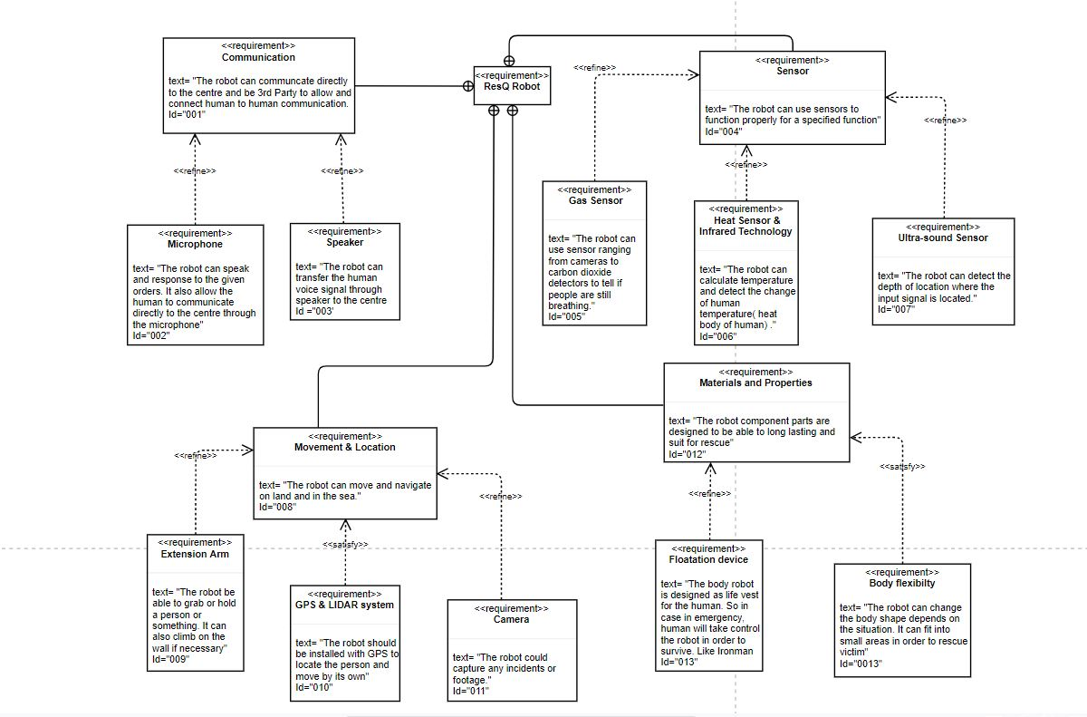
REQUIREMENT DIAGRAM
The Requirement Diagram (fig 1) shows a graphical representation of all our project requirements.
Fig. 1 Requirement diagram

Slide 4
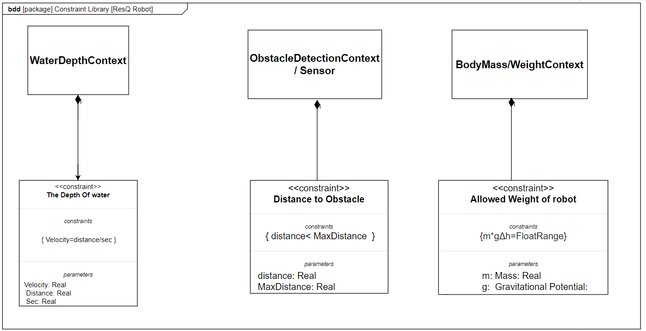
CONSTRAINT/CONTEXT DIAGRAM
The constraint diagram (Fig. 2) basically specifies a network of constraints that shows mathematical expressions, these constraints are mostly from physical properties of a system.
Fig. 2 Constraint Diagram

Slide 5
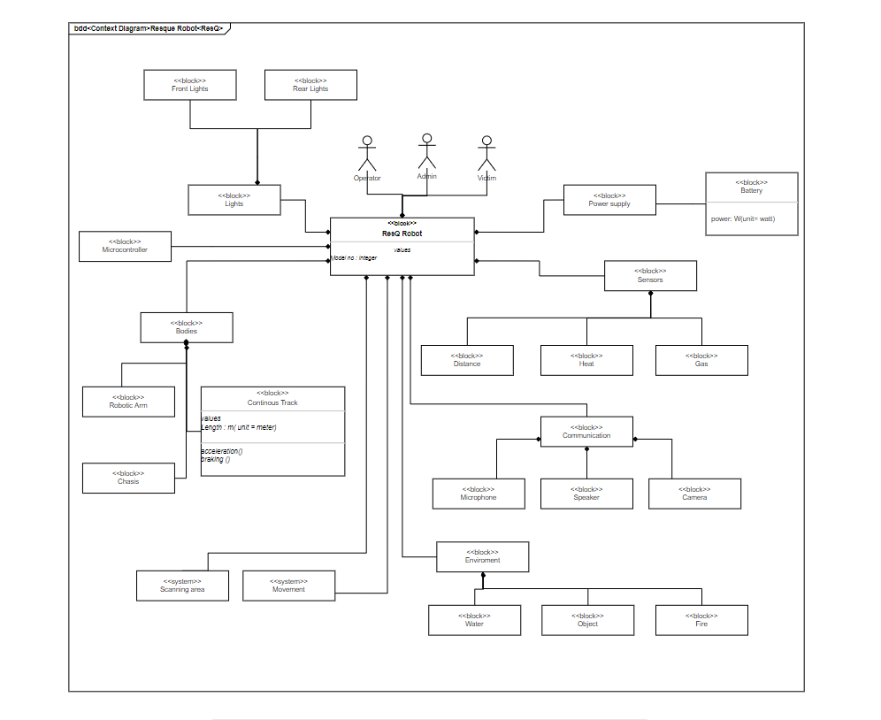
Block diagram
The Block Diagram (Fig 3) shows the modular unit of our system, which abridges the contents such as the operations, attributes and constraints of our system.
Fig. 3 Block Diagram

Slide 6
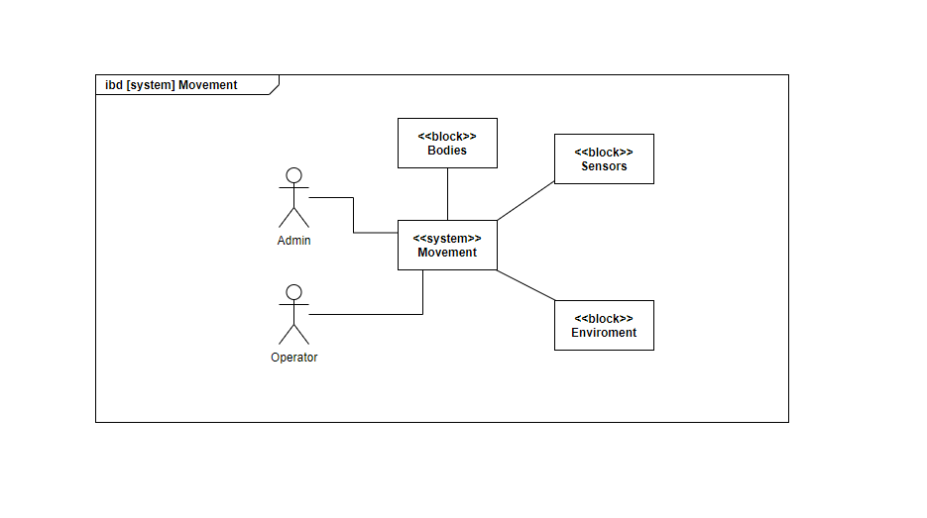
INTERNAL BLOCK DIAGRAM
The Internal Block Diagram (Fig. 4) shows a graphical view of the internal structure of a block in our system.
Fig. 4 Internal Block Diagram

Slide 7
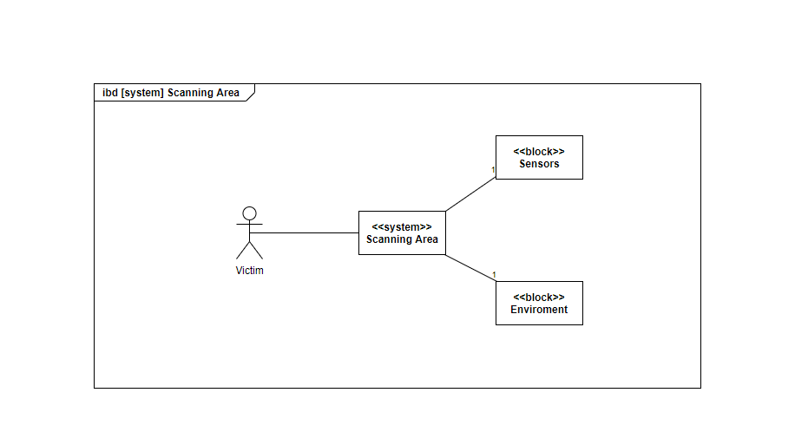
The Scanning Area (IBD)
The Scanning area (Fig.5) is a segment of the internal block diagram, showing how our robot navigates around the environment and searches for the victim.
Fig. 5 Scanning Area

Slide 8
Technische Voraussetzungen
Netzwerk
Satellit
Link

Slide 9

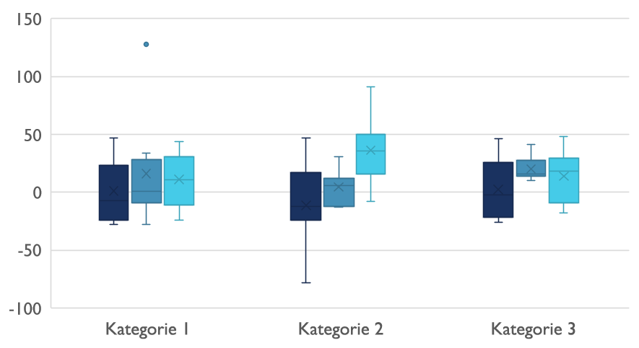
Wettbewerbsumfeld

Slide 10

Digitale Kommunikation
Wolke
Regionalität
Hybrid

Slide 11

Vielen Dank
jemand@example.com

